Slide 1
SYN Flooding
Andoni Alfonso, Emmanuel Elias, Garrett Bowman
Dr. Janise Mcnair
EEL4598

Slide 2
Overview
Transmission Control Protocol (TCP)
Synchronize (SYN)
Synchronize-Acknowledge (SYN-ACK)
Acknowledge (ACK)
SYN Flood
Thousands of spoofed connection requests
Return of SYN-ACK messages
Issues, such as slowed connection or crashing

Slide 3
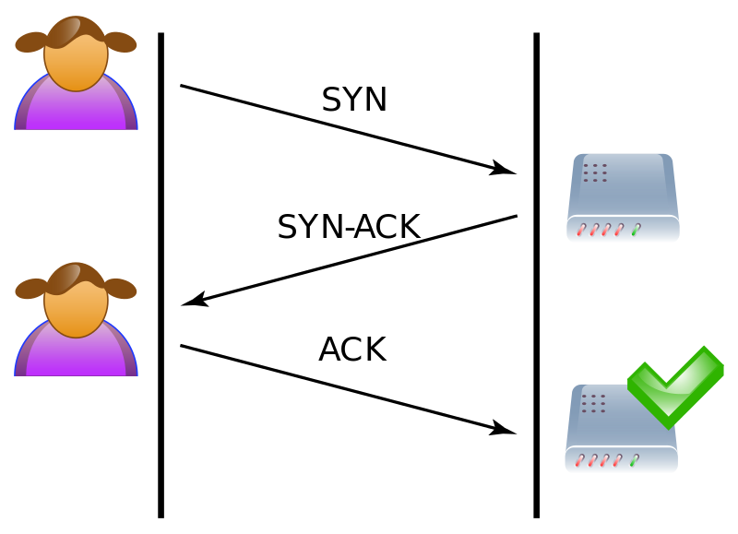
Three-Way Handshake Example

Slide 4
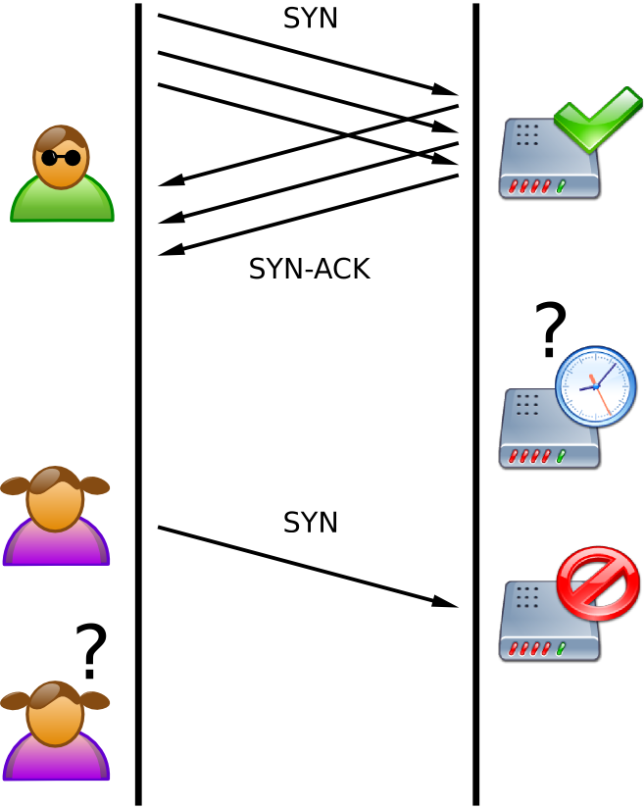
SYN Flood Example

Slide 5
Major Attack(s)
Panix SYN Flood (1996)
Occurred in New York in September of 1996
Thousands of users without Interest access
Certain details undisclosed
Wikileaks Attacks (2010)
Website targeted by DDoS attacks, included use of SYN floods
Yahoo! Attack (2000)
Boston Bomb Scare (2007)
University of California, San Francisco Ransomware Attack (2020)

Slide 6
Difficulty and Counteractions
Difficulty:
Sizable amount of traffic
Quickness of attack
Doctored IP addresses
Counteractions:
Limitation rate of SYN packets
Implementing security systems

Slide 7
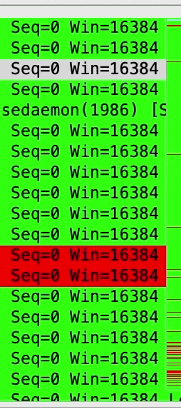
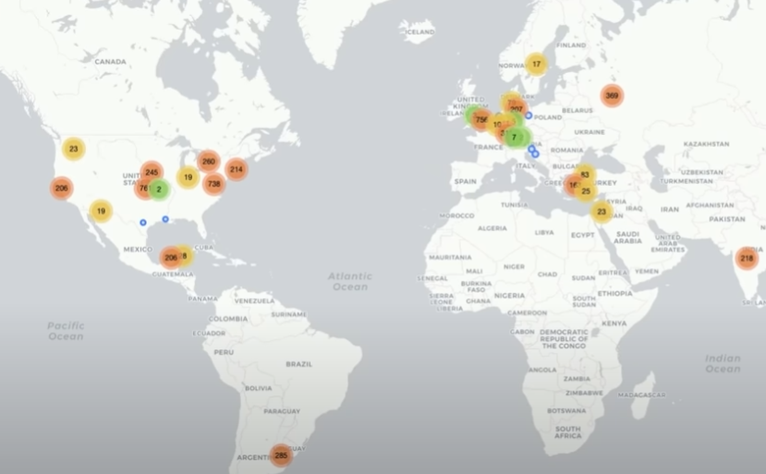
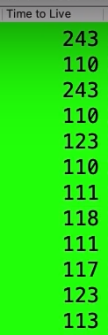

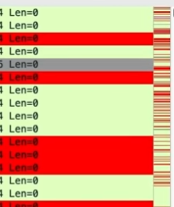
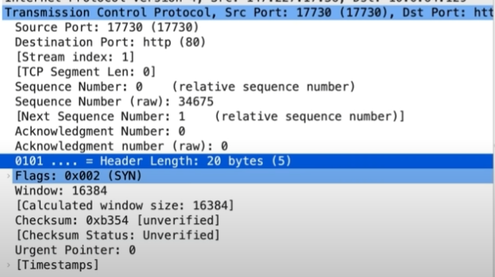
How to Identify SYN Flooding in Wireshark

